Slide 1
Bloom’s Taxonomy
Practice Quiz
Teams of 2 or 3!

Slide 2
Let’s Practice:
What level of Bloom’s Taxonomy would the following activities require? You may want to think about the highest level each could possibly be, and then determine what would be needed to take the task to an even higher level.
1.Changing a flat tire?

Slide 3
-Application

Slide 4

2. Finding the main idea of a paragraph

Slide 5
-Comprehension

Slide 6
3. Explaining the previous day’s class lecture to a student who was absent.

Slide 7
-Comprehension

Slide 8

4. Summarizing an article in your own words.

Slide 9
-Comprehension

Slide 10

5. Finding the lowest common denominator for fractions

Slide 11
-Analysis

Slide 12
6. Choosing the correct answer (terms) to multiple choice questions
A.
B.
C.
D.

Slide 13
-Knowledge

Slide 14
Creating a webpage

Slide 15
-Synthesis

Slide 16
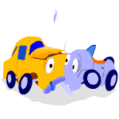
8. Appraising the cause and the
damage to your car after a wreck.

Slide 17
-Evaluation

Slide 18
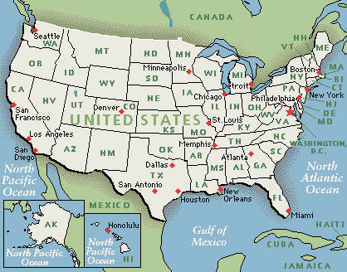
9. Listing the USA states and their capitals.

Slide 19
-Knowledge

Slide 20
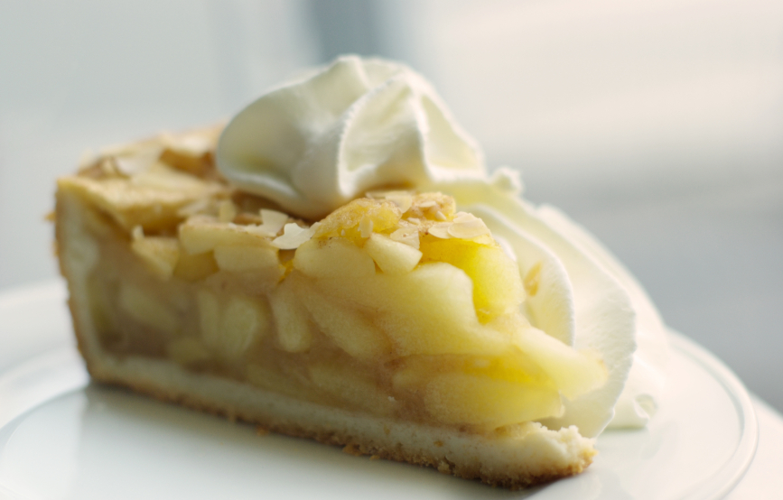
10. Making your favorite and apple pie for your family.

Slide 21
-Application

Slide 22
11. Coming up with your own recipe for a baking contest

Slide 23
-Synthesis

Slide 24

12. Comparison shopping for the best buy

Slide 25
-Evaluation

Slide 26

13. Writing an essay for your English 1001G class

Slide 27
-Synthesis

Slide 28

14. Computing your GPA

Slide 29
-Application

Slide 30
Sources: http://www.officeport.com/edu/bloomq.htm http://frank.mtsu.edu/~studskl/

